Slide 1
Gauteng Xamarin UG
creating Xamarin native bindings
Matthew Leibowitz
matthew.leibowitz@xamarin.com / maleib@microsoft.com
@mattleibow

Slide 2

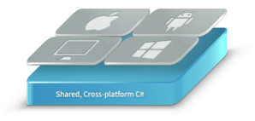

Agenda
The Microsoft Band
The Native Bindings
The Portable Class Library
The NuGet Package
The Xamarin Component
Conclusions

Slide 3
The Microsoft Band

Slide 4
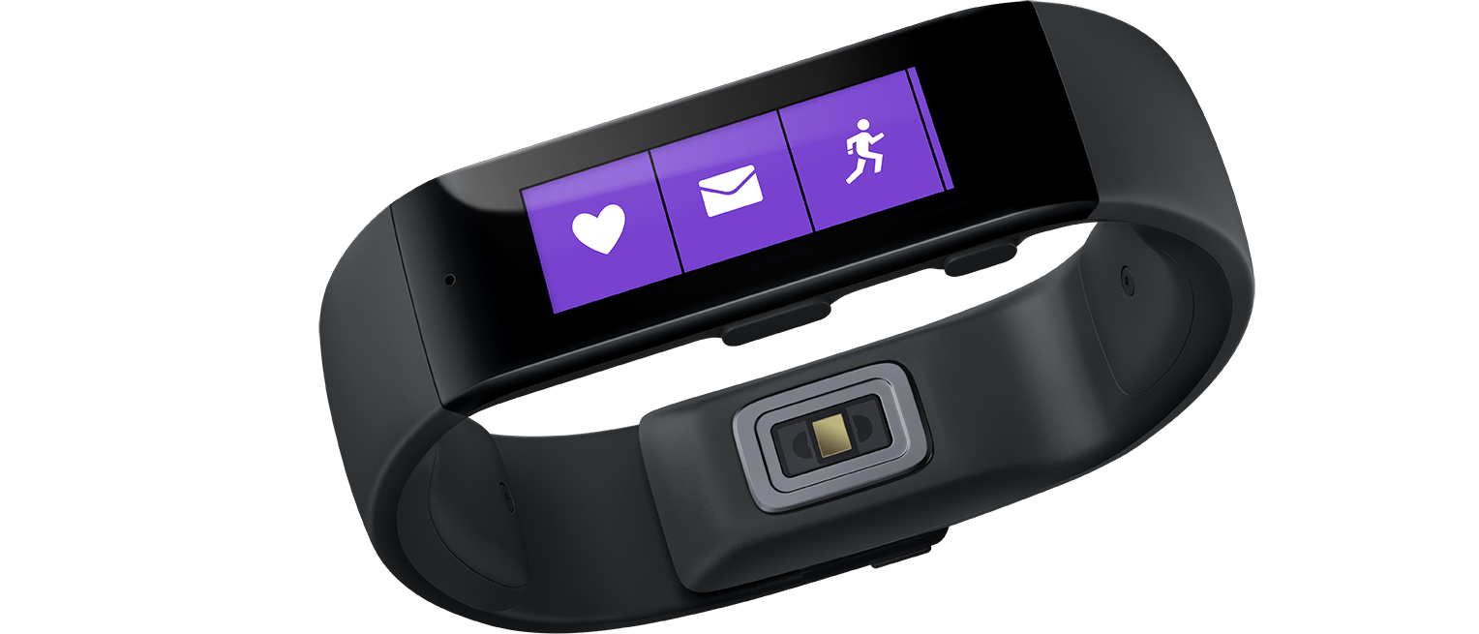
What is the Microsoft Band?
A smart band with smartwatch features
Filled with sensors
Long battery life
Cross-platform support
Notes:
10 physical sensors, but more logical
- Accelerometer – step counter
- Heart Rate – calories

Slide 5
The Native Bindings
Notes:
This means we can take any Java / Objective-C library and wrap it automatically into a C# and .NET assembly

Slide 6
The Native SDK
Java SDK for Android
Objective-C SDK for iOS
C# SDK for Windows Phone
C# SDK for Windows Store
3 languages, 3 patterns, 3 times
Notes:
Quite good, it follows the native platform patterns
Three languages – WP/WS use the same, but they aren’t true PCL libraries
Each app flows slightly differently and requires different objects

Slide 7
The Xamarin Native SDK
C# SDK for Android
C# SDK for iOS
C# SDK for Windows Phone
C# SDK for Windows Store
1 language, 3 patterns, ~3 times
Notes:
Just dropping the iOS/Android library into the tools and letting it do the work.
Straight bindings are fairly easy. Most of the time, they only require a few tweaks in order to get them to work.
However, they are very platform-style APIs
- Still follows the platform and language patterns
- listeners in Android,
delegates in iOS
- AsyncTask in Android,
completion handlers in iOS

Slide 8
The Improved Xamarin Native SDK
C# SDK for Android
C# SDK for iOS
C# SDK for Windows Phone
C# SDK for Windows Store
1 language, 1 pattern, ~3 times
Notes:
Using overloads instead of numerous methods
Using properties instead of getters/setters
Making the asynchronous methods use Task, async and await
Using events instead of listeners
Converting NSMutableArray into .NET collections

Slide 9
The Portable Class Library

Slide 10
What are Portable Class Libraries (PCL)?
An assembly that is not restricted to a specific platform
Types are mapped to their real types
Usable by other PCLs

Slide 11
The Same API & Code
Simply use a portable assembly everywhere
Pros:
Write once, test once, run everywhere
Cons:
The API is usually not as large

Slide 12
The Same API & Few Code Differences
Use a portable assembly everywhere
Abstract platform differences into base types or interfaces
Pros:
Clean code
Cons:
Quite a few types
Notes:
Not recommended if there are multiple types that need sharing as this results in exponential type incteases

Slide 13
The Same API & Quite Different Code
Create a dummy portable assembly
Make use of the “bait-and-switch” pattern
Pros:
Easy to consume
Cons:
Code might become messy

Slide 14
The NuGet

Slide 15
What are NuGets?
A zip archive that contains a collection of assemblies, scripts and files
Contains folders for each platform
The IDE selects the files from the correct folder
Pros
Consumable from Visual Studio/Xamarin Studio/MonoDevelop
Versioned Dependency tracking
Cons
Vast pit of them
Not monitored/controlled

Slide 16
The Xamarin Component

Slide 17
What are Xamarin Components?
A zip archive that contains a collection of assemblies, scripts and files
Contains folders for each platform
The IDE selects the files from the correct folder
Pros
Curated list
Samples/Documentation/Guaranteed cross-platform
Cons
Requires Xamarin

Slide 18
Xamarin Components Can Use NuGets!
Best of both worlds
Pros
Highly visible packages
Great interface
Cons
Nothing ☺

Slide 19
Conclusions

Slide 20
Links
Microsoft Band Developer Page http://developer.microsoftband.com/
NuGet https://nuget.org/packages/Xamarin.Microsoft.Band/
Xamarin Component http://components.xamarin.com/view/microsoft-band-sdk
GitHub https://github.com/mattleibow/Microsoft-Band-SDK-Bindings
Xamarin Components https://github.com/xamarin/XamarinComponents

